Slide 1


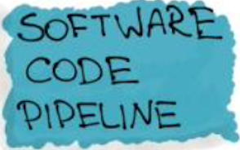
ML Engineering Workflow
Team: E.ON
Chaitanya Shinde
Richard Jasansky
Dominik Schäfer
Michael Fuest
Nick Knappstein
Version Control [Git]
COMPETITOR DATA
Gas dataset
Power dataset
Merging the competitor data and energy prices
FEATURE ENGINEERING
Validity period
Base/ Spot/ Peak prices
Strategy index based on average supplier ranking
ENERGY PRICES
Year/ day ahead future prices
Spot prices
MONITORING & LOGGING
FEEDBACK
New data from model performance
EXTERNAL DATA
Household energy consumption
DATA WRANGLING
Removing invalid dates (9999-12-31)
Formatting data types
Removing NAN values
Indexing dates
Model
Decay
Trigger
EXPLORATION & VALIDATION
Aggregating duplicate values
Descriptive Analysis
Figuring out correlations between features
Deriving first insights based on the average distribution of suppliers’ average ranking
MASTER DATA SET
TRAIN
80%
TEST
20%
APPROACHES
Identify the most important instruments for suppliers via reactions to price changes
How regularly do suppliers update their prices (validity period)
Is there a correlation between a main supplier and followers?
Moving averages as a proxy for pricing strategy
Moving average time window (e.g. 7 days for a short-term period or longer for wider trends)
Segmentation of postcodes to see what the effect is on pricing strategy
Feature Engineering
Hyperparameter Tuning
Best model selection
MODEL ENGINEERING
Clustering (Unsupervised)
Regression
Reinforcement Learning
MODEL EVALUATION
Accuracy; Precision; Recall
MODEL PACKAGING
MODEL
CODE
BUILD & INTEGRATION TESTING
DEPLOYMENT

